Slide 1




Duke / Richman
GLCRCI-11062025R1
Progress Update 05
Dec 11th, 2025

Slide 2
GLCRCI-11062025R1
PROJECT OVERVIEW:
GLC will perform the synthesis on a small scale to gain familiarity with the process and generate material on a non-GMP basis.
After the non-GMP delivery, GLC will finalize its GMP quotation to Duke/Richman.
2

Slide 3
GLCRCI-11062025R1
LDN-214117 Synthesis:
3

Slide 4
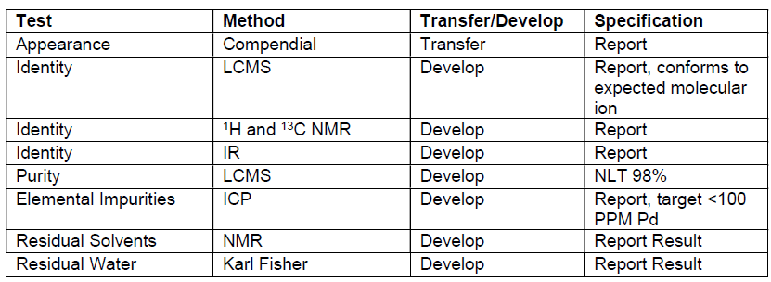
GLCRCI-11062025R1
LDN-214117 non-GMP Draft Specifications
4

Slide 5
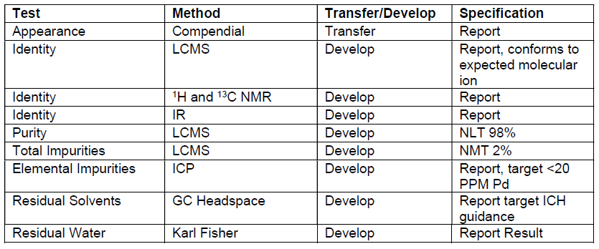
GLCRCI-11062025R1
LDN-214117 cGMP Draft Specifications
5

Slide 6
GLCRCI-11062025R1
Step 1: Suzuki coupling by using 1.10 eq compound 2 boronic acid and K₂CO₃ as base, scale-up reaction
No. | Scale | Description (in order of addition) | Comments
1 | 10.0 g | 3-Bromo-5-chloro-2-methylpyridine (10. g, 1.0 eq), 3,4,5-Trimethoxyphenylboronic acid (1.10 eq), Palladium tetrakis(triphenylphosphine) (0.05 eq), K₂CO₃ (3.0 eq), DME (8V), water (2V), 85°C, 20h. | Charged 3-Bromo-5-chloro-2-methylpyridine (10. g, 1.0 eq) &, 3,4,5-Trimethoxyphenylboronic acid (11.3 g, 1.10 eq) into a seal tube Added 1,2-Dimethoxyethane (80 mL, 8 V) and water (20 mL, 2 V) Added K₂CO₃ (20.1 g, 3.0 eq) at RT Degassed with nitrogen for 5-10 min Added palladium tetrakis(triphenylphosphine) (2.8 g, 0.05 eq) Degassed with nitrogen for 5-10 min Heated to 85 °C and stirred for 6 h Checked LCMS & HPLC after 6 h (~4.6 % SM vs product 3 observed by HPLC) Continu the heating at 85 °C and stirred for another 16 h Checked HPLC after 20 H (~ 0.17% SM vs product 3 observed by HPLC) Cooled to RT Filtered to remove the observed solids, washed with EtOAc (50 mL, 5V) Charged water (50 mL, 5 V) and stirred for 10 min at RT Layers separated and aq. layer back extracted with EtOAc (50 mL 5 V) Combined the both layers and washed with brine solution (50 mL, 5 V) Evaporated under vacuum at 40-45 °C, obtained a thick syrup Slowly charged MTBE (50 mL, 5 V), solid precipitated Stirred at RT for 1 h Filtered and washed with MTBE (2 V) Dried under vacuum at 45-50 °C Yield:10.3 g (72%) ¹H-NMR and LCMS confirms conforms with Int-3. HPLC Purity: 99.42%
6

Slide 7
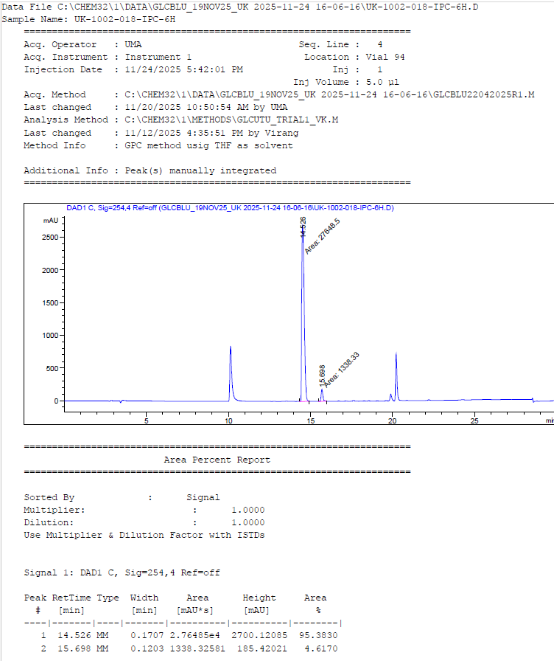
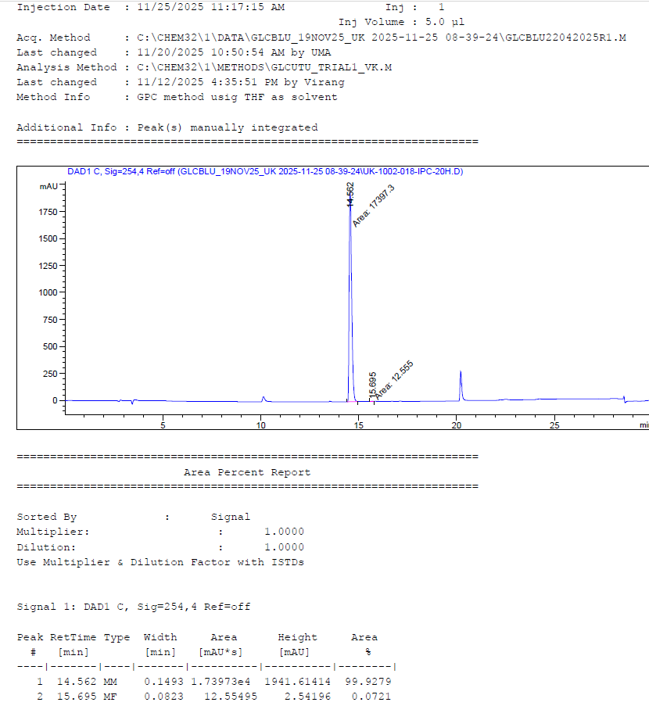
GLCRCI-11062025R1
Step-1: HPLC of intermediate-3 IPC, 6h (95.38%) & 20 h (99.92%)
IPC - 6 h
IPC - 20 h
7

Slide 8
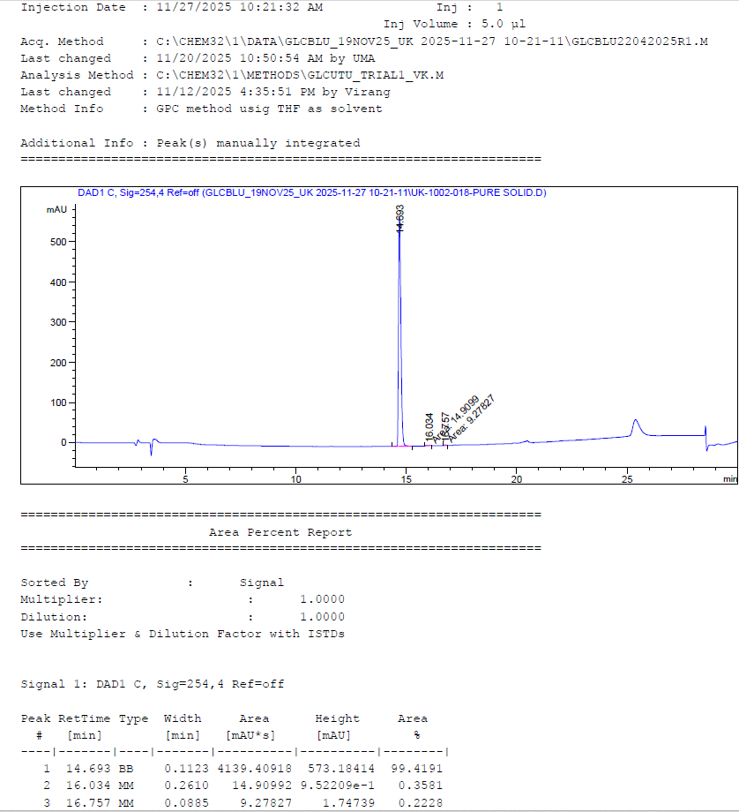
GLCRCI-11062025R1
Step-1: HPLC of Intermediate-3, 99.42 area %
8

Slide 9
GLCRCI-11062025R1
Step-1: ¹H NMR of Intermediate-3, Single Crop Isolation
9

Slide 10
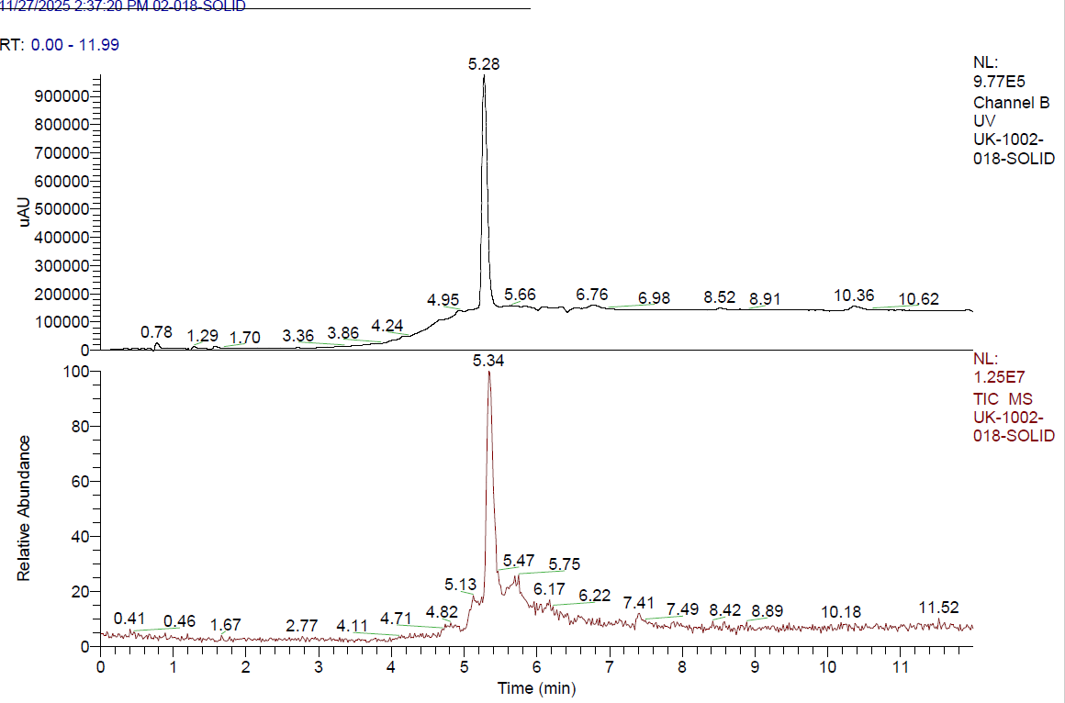
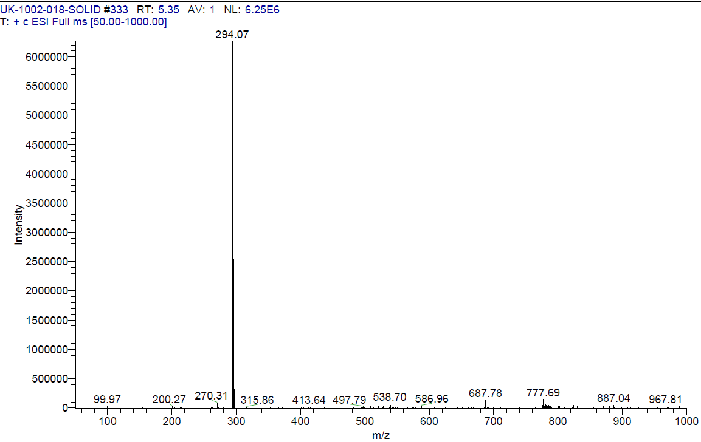
GLCRCI-11062025R1
Step-1: LCMS of Intermediate-3, Single Crop Isolation
m/z = 294.07 [M+1]⁺
10

Slide 11
GLCRCI-11062025R1
Step 2: Suzuki coupling (Familiarization with 1.0 eq. vs 1.3 eq. compound 4, 0.05 eq. vs 0.20 eq. Xphos Pd G3 cat. and Cs₂CO₃)
No. | Scale | Description (in order of addition) | Comments
2 | 0.5 g | Intermediate-3 (0.5 g, 1.0 eq), 4-(4-Boc-piperazino)phenylboronic acid (4) (1.00 eq), Xphos Pd G3 (0.05 eq), Cs₂CO₃ (3.0 eq), Toluene (8 V), water (2 V), 110 °C, 18 h. | Charged Intermediate-1 (Compound-3, 0.5 g, 1.0 eq.) & 4-(4-Boc-piperazino)phenylboronic acid (4, 0.52 g, 1.00 eq.) in a seal tube under nitrogen Added toluene (4 mL, 8 V), water (1 mL, 2 V) and Cs₂CO₃ (1.74 g, 3.0 eq) Degassed with nitrogen for 5 min Added Xphos Pd G3 (7 mg, 0.05 eq.) Degassed with nitrogen for 5 min Heated to 110 °C and stirred for 6 h Checked HPLC after 6 h (~42% SM vs product 5 observed by HPLC) Continue heating for another 14 h Checked HPLC after 20 h (~40% SM vs product 5 observed by HPLC) Cooled to RT Added Xphos Pd G3 (7 mg, 0.05 eq.) Heated to 110 °C and stirred for another 16 h Checked HPLC after 36 h (~34% SM vs product 5 observed by HPLC) Cooled to RT Added 4-(4-Boc-piperazino)phenylboronic acid (4, 0.16 g, 0.3 eq.) Xphos Pd G3 (7 mg, 0.05 eq.) Heated to 110 °C and stirred at 110 °C, checked IPC (~56 h) Checked HPLC after 40 h and 56 h (~26.0% and 20.5% SM vs product 5 observed by HPLC) Cooled to RT Added 4-(4-Boc-piperazino)phenylboronic acid (4, 0.16 g, 0.3 eq.) Xphos Pd G3 (7 mg, 0.05 eq.) Heated to 110 °C and stirred at 110 °C, checked IPC (~72 h) Checked HPLC after 72 h (~0.18 % SM vs product 5 observed by HPLC) Cooled to RT, filtered through Celite, washed with toluene (2.5 mL, 5 V) Charged water (2.5 mL, 5 V) Layers were separated and aq. layer back extracted with toluene (2.5 mL, 5 V) Combined the both layers and washed with brine solution (2.5 mL, 5 V) Evaporated under vacuum at 40-45 °C, obtained a thick brown syrup Combined the crude syrup for isolation with the subsequent scale-up batch
11

Slide 12
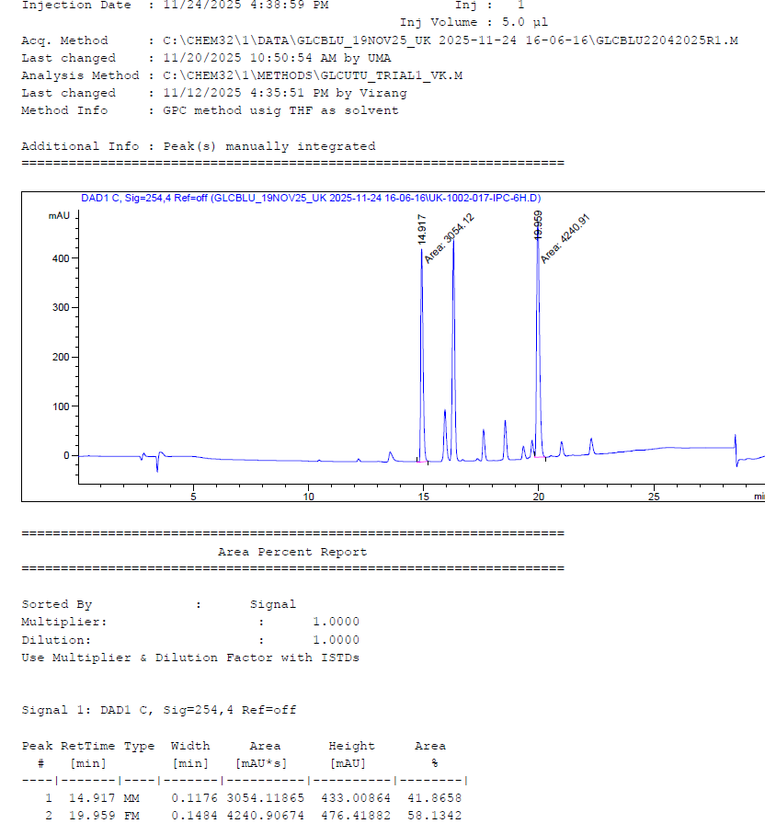
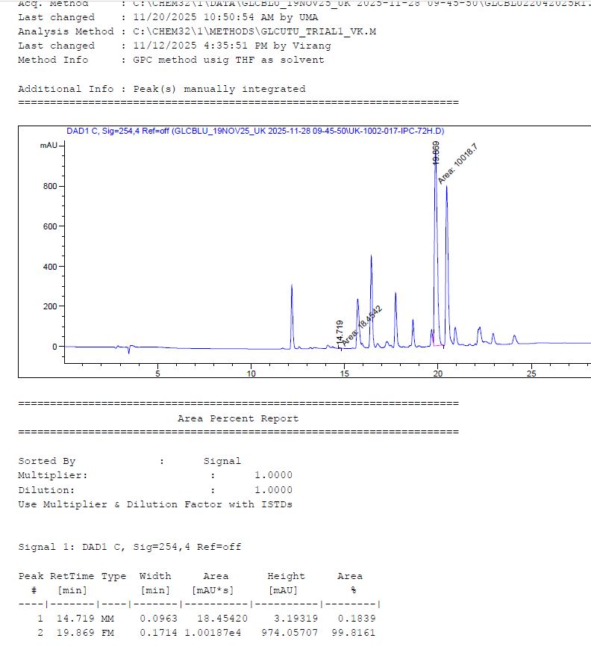
GLCRCI-11062025R1
Step-2: HPLC of intermediate-5 IPC, 6 h (58.13%) & 72 H (99.82%)
IPC – 72 h
IPC - 6 h
12

Slide 13
GLCRCI-11062025R1
Step 2: Suzuki coupling with 1.30 eq. compound 4, Xphos Pd G3 cat. and Cs₂CO₃), Scale-up Batch
No. | Scale | Description (in order of addition) | Comments
3 | 5.0 g | Intermediate-3 (5.0 g, 1.0 eq), 4-(4-Boc-piperazino)phenylboronic acid (4) (1.30 eq), Xphos Pd G3 (0.20 eq), Cs₂CO₃ (3.0 eq), Toluene (8 V), water (2 V), 110 °C, 18 h. | Charged Intermediate-1 (Compound-3, 5.0 g, 1.0 eq.) & 4-(4-Boc-piperazino)phenylboronic acid (4, 5.73 g, 1.30 eq.) in a sealed tube vessel under N₂ Added toluene (40 mL, 8 V), water (10 mL, 2 V) and Cs₂CO₃ (17.4 g, 3.0 eq) Degassed with nitrogen for 5 min Added Xphos Pd G3 (2.88 g, 0.20 eq.) Degassed with nitrogen for 5 min Heated to 110 °C and stirred for 16 h Checked HPLC after 16h (~0.05% SM residual) Cooled to RT, filtered through Celite, washed with toluene (25 mL, 5 V) Charged water (25 mL, 5 V) Layers were separated and aq. layer back extracted with toluene (25 mL, 5 V) Combined the both layers and washed with brine solution (25 mL, 5 V) Evaporated under vacuum at 40-45 °C, obtained a thick black syrup Dissolved in DCM (25 mL, 5V) and filtered through Celite, washed with DCM (10 mL, 2 V), evaporated under vacuum at 40-45 °C, obtained a thick brown syrup Slowly added MTBE (10 V) at RT, solid crystallized Stirred at RT for 1 h Filtered and washed with MTBE (10 mL, 2 V) Dried under vacuum at 45-50 °C Yield: 5.80 g (60%) ¹H-NMR and LCMS confirms with Int-5 HPLC Purity: 96.15%
13

Slide 14
GLCRCI-11062025R1
Step-2: HPLC of intermediate-5 IPC (~99.81% conversion)
14

Slide 15
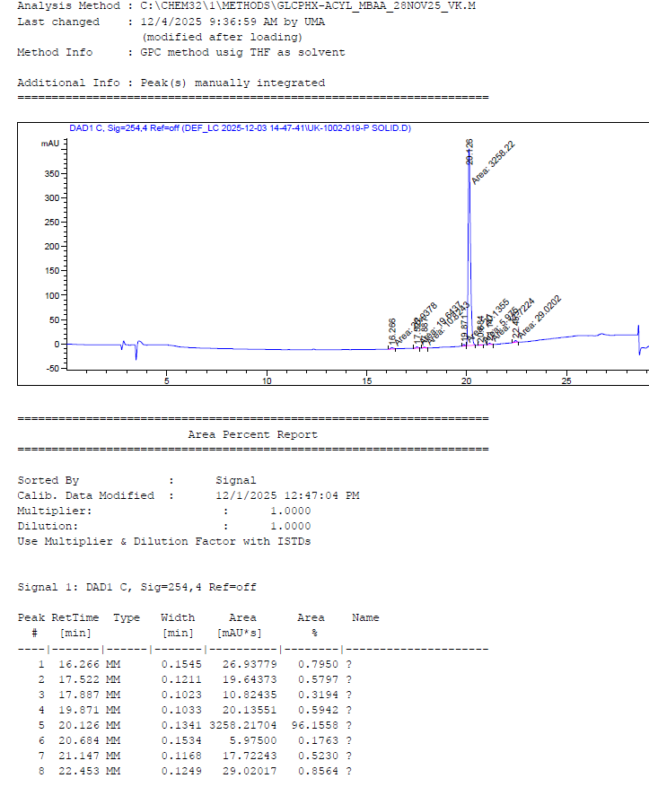
GLCRCI-11062025R1
Step-2: HPLC of Intermediate-5, 96.15% area
15

Slide 16
GLCRCI-11062025R1
Step-2: ¹H NMR of Intermediate-5
16

Slide 17
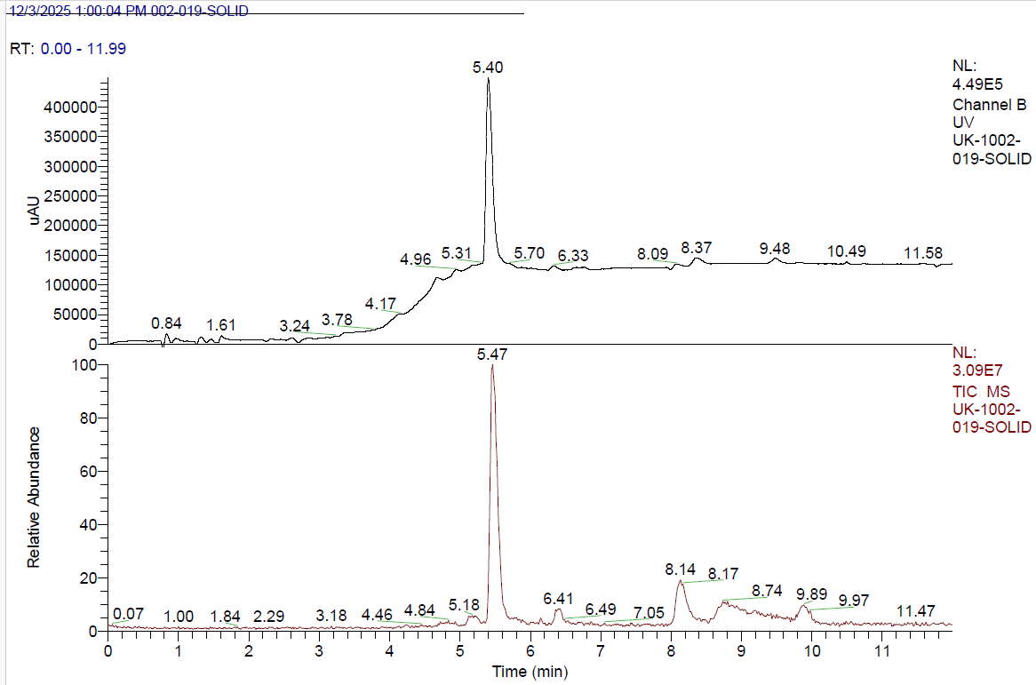
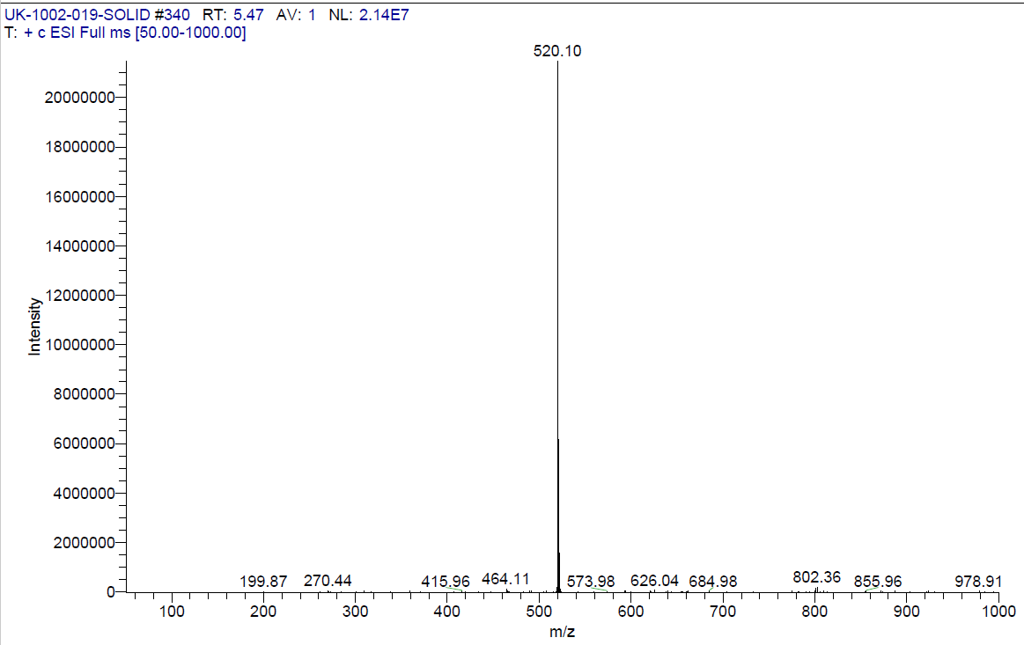
GLCRCI-11062025R1
Step-2: LCMS of Intermediate-5 IPC
m/z = 520.10 [M+1]⁺
17

Slide 18
GLCRCI-11062025R1
Step 2: Suzuki coupling with 1.30 eq. compound 4, Xphos Pd G3 cat. and Cs₂CO₃ and SiliaMetS Thiol scavenger treatment in DCM
No. | Scale | Description (in order of addition) | Comments
4 | 3.5 g | Intermediate-3 (3.5 g, 1.0 eq), 4-(4-Boc-piperazino)phenylboronic acid (4) (1.30 eq), Xphos Pd G3 (0.15 eq), Cs₂CO₃ (3.0 eq), Toluene (8 V), water (2 V), 110 °C, 18 h. | Charged Intermediate-1 (Compound-3, 3.5 g, 1.0 eq.) & 4-(4-Boc-piperazino)phenylboronic acid (4, 4.01 g, 1.30 eq.) in a sealed tube under nitrogen Added toluene (28 mL, 8 V), water (7 mL, 2 V) and Cs₂CO₃ (12.2 g, 3.0 eq) Degassed with nitrogen for 5 min Added Xphos Pd G3 (2.02 g, 0.15 eq.) Degassed with nitrogen for 5 min Heated to 110 °C and stirred for 16 h Checked HPLC after 16h (~0.08% SM residual) Cooled to RT, filtered through Celite, washed with toluene (17.5 mL, 5V) Charged water (17.5 mL, 5 V) Layers were separated and aq. layer back extracted with toluene (17.5 mL, 5 V) Combined the both layers and washed with brine solution (17.5 mL, 5 V) Evaporated under vacuum at 40-45 °C, obtained a thick black semi solid Semi solid crude wt: 12.25 g
18

Slide 19
GLCRCI-11062025R1
Step 2: SiliaMetS Thiol Scavenger 20% & 30% treatment in DCM for Pd Remediation
No. | Scale | Description (in order of addition) | Comments
5 | ~0.5 g | Step-2 crude (Compound-5, 3.5 g ~0.5 g), SiliaMetS Thiol (100 mg, 20 wt %), DCM (5 mL, 10 V), 20-25 °C, 2 h. | Charged crude Intermediate-5 black semi solid (3.5 g, containing ~0.5 g Compound-5) & DCM (5 mL, 10 V) in a 50 mL RBF Added SiliaMetS Thiol solid (100 mg, 20 wt %) at RT Stirred at RT for 2 h Filtered through Celite bed (sintered funnel), washed with DCM (5 mL, 10 V) Evaporated under vacuum at 40-45 °C, obtained a thick brown syrup Slowly added MTBE (10 V) at RT, solid crystallized Stirred at RT for 1 h Filtered and washed with MTBE (2 mL, 4 V) Dried under vacuum at 45-50 °C Dry solid wt: 552 mg Sample sent for IPC analysis to check Pd content
6 | ~0.5 g | Step-2 crude (Compound-5, 3.5 g ~0.5 g), SiliaMetS Thiol (150 mg, 30 wt %), DCM (5 mL, 10 V), 20-25 °C, 2 h. | ChargedSent crude Intermediate-5 black semi solid (3.5 g, containing ~0.5 g Compound-5) & DCM (5 mL, 10 V) in a 50 mL RBF Added SiliaMetS Thiol solid (150 mg, 30 wt %) at RT Stirred at RT for 2 h Filtered through Celite bed (sintered funnel), washed with DCM (5 mL, 10 V) Evaporated under vacuum at 40-45 °C, obtained a thick brown syrup Slowly added MTBE (10 V) at RT, solid crystallized Stirred at RT for 1 h Filtered and washed with MTBE (2 mL, 4 V) Dried under vacuum at 45-50 °C Dry solid wt: 530 mg Sample sent for IPC analysis to check Pd content
19

Slide 20
GLCRCI-11062025R1
Step 2: SiliaMetS Thiol Scavenger 50% treatment in DCM for Pd Remediation
No. | Scale | Description (in order of addition) | Comments
7 | 0.5 g | Step-2 crude (Compound-5, 3.5 g ~0.5 g), SiliaMetS Thiol (250 mg, 50 wt%), DCM (5 mL, 10 V), 20-25 °C, 2 h. | Charged crude Intermediate-5 black semi solid (3.5 g, containing ~0.5 g Compound-5) & DCM (5 mL, 10 V) in a 50 mL RBF Added SiliaMetS Thiol solid (250 mg, 50 wt%) at RT Stirred at RT for 2 h Filtered through Celite bed (sintered funnel), washed with DCM (5 mL, 10 V) Evaporated under vacuum at 40-45 °C, obtained a thick brown syrup Slowly added MTBE (10 V) at RT, solid crystallized Stirred at RT for 1 h Filtered and washed with MTBE (2mL, 4 V) Dried under vacuum at 45-50 °C Dry solid wt: 523 mg Sample sent for IPC analysis to check Pd content
20

Slide 21
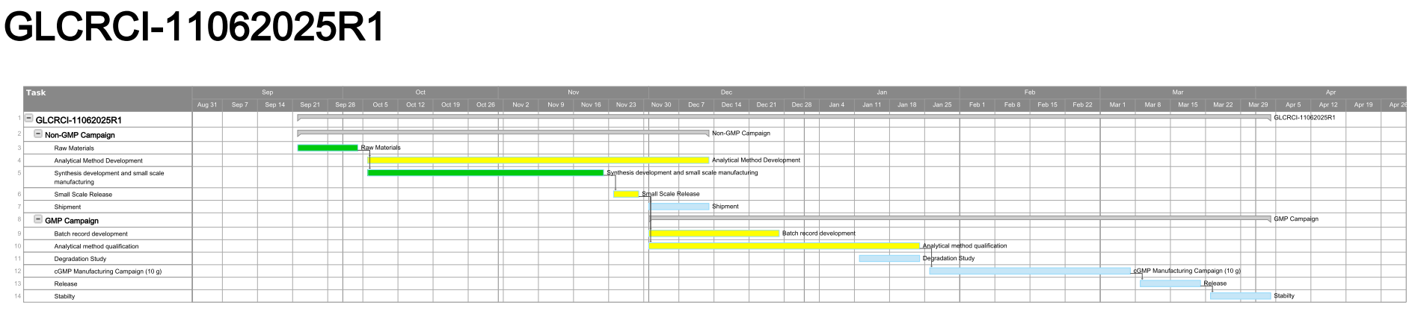
GLCRCI-11062025R1
Gantt Chart
21

Slide 22
Thank You!
22

